Slide 1
ME759 High Performance Computing for Applications in Engineering [Spring 2020]
Lecture 26
03/30/2020
Dan Negrut, 2020 ME759 UW-Madison

Slide 2
Things to do, for Canvas live-session
Dan: start the Canvas recording
Everybody else:
Please mute your microphone
Please ask questions (limit: two per person per lecture; after that, post on Piazza)
When you ask questions, first unmute your mic

Slide 3
The quote the day
“Kids, you tried your best and you failed miserably. The lesson is, never try.”
-- Home Simpson, Nuclear Safety Inspector [1989 - ]

Slide 4
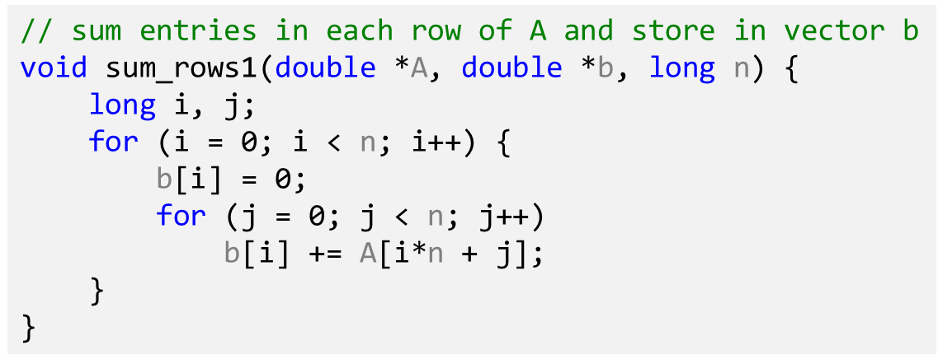
Before we get going…
Last time:
Optimization aspects
Help the compiler help you
Memory aliasing
Today:
Optimization aspects, wrap up
Start parallel computing w/ MPI
Other tidbits:
ME759 Exam: April 15, at 7:15 PM, in Canvas
Review: Tu, April 14, at 7:00 PM, in Canvas
Final Project Proposal: Dan to provide feedback this week
Last ME759 lecture is on Friday

Slide 5
New Example, w/ 2 actors – a struct + two functions
len
0
1
len-1
Our struct will use various Data Types
Use different declarations for data_t:
int
long
float
double
data
/* data structure for vectors */
typedef struct {
size_t len;
data_t *data;
} vec;
/* retrieve vector element and store in val */
void get_vec_element(*vec v, size_t idx, data_t *val) {
if (idx >= v->len || idx < 0)
*val = 0;
else
*val = v->data[idx];
}
The first function that comes into play
[15-213 @ CMU]$→$

Slide 6

Wrapping up the setup, for the new example
void combine1(vec_ptr v, data_t *dest) {
*dest = IDENT; // the identity value for OP
for (int i = 0; i < vec_length(v); i++) {
data_t val;
get_vec_element(v, i, &val);
*dest = *dest OP val;
}
}
Compute sum or product of vector elements (based on OP)
The second function that comes into play
Data Types
Use different declarations for data_t
int
long
float
double
Operations (OP)
Use different definitions of OP and IDENT
“+” : 0
“*” : 1
[15-213 @ CMU]$→$

Slide 7
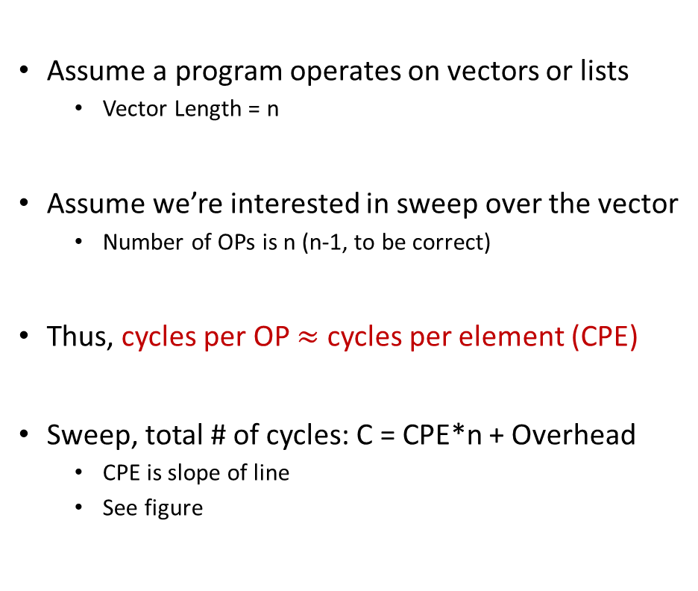
Cycles Per Element (CPE)
Assume a program operates on vectors or lists
Vector Length = n
Assume we’re interested in sweep over the vector
Number of OPs is n (n-1, to be correct)
Thus, cycles per OP $≈$ cycles per element (CPE)
Sweep, total # of cycles: C = CPE*n + Overhead
CPE is slope of line
See figure
psum1
Slope = 9.0
psum2
Slope = 6.0
[15-213 @ CMU]$→$

Slide 8
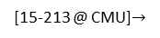
Benchmark Performance
void combine1(vec_ptr v, data_t *dest) {
*dest = IDENT; // the identity value for OP
for (int i = 0; i < vec_length(v); i++) {
data_t val;
get_vec_element(v, i, &val);
*dest = *dest OP val;
}
}
Sweep to compute sum or product of vector elements
Results in CPE (cycles per element) – Smaller is BETTER!
Method | data_t: Integer |  | data_t: Double FP
Operation (OP) | add | mult | add | mult
combine1 unoptimized | 22.68 | 20.02 | 19.98 | 20.18
combine1 with –O1 | 10.12 | 10.12 | 10.17 | 11.14
combine1 with –O3 | 4.5 | 4.5 | 6 | 7.8
[15-213 @ CMU]$→$

Slide 9
Basic Optimizations
No function call here anymore
void combine4(vec_ptr v, data_t *dest) {
int length = vec_length(v);
data_t *d = get_vec_start(v);
data_t temp = IDENT;
for (int i = 0; i < length; i++)
temp = temp OP d[i];
*dest = temp;
}
Shortcut: you get the raw pointer, and index into it… No need to call get_vec_element
Modification #1: vec_length moved out of loop
One function call avoided at each iteration
Modification #2: bypassed get_vec_element call
Modification #3: Accumulate in temporary “temp”
[15-213 @ CMU]$→$

Slide 10
Effect of Basic Optimizations
void combine4(vec_ptr v, data_t *dest) {
int length = vec_length(v);
data_t *d = get_vec_start(v);
data_t temp = IDENT;
for (int i = 0; i < length; i++)
temp = temp OP d[i];
*dest = temp;
}
Method | Integer |  | Double FP
Operation | add | mult | add | mult
combine1 –O1 | 10.12 | 10.12 | 10.17 | 11.14
combine4 | 1.27 | 3.01 | 3.01 | 5.01
Eliminates overhead in loop & can do prefetching
[15-213 @ CMU]$→$

Slide 11
Opportunities for Efficiency Gains
Cluster (distributed mem.)
Group of nodes communicate through fast interconnect
MPI, Charm++, Chapel
Multi-Socket Node
Group of CPUs on the same node, talk through main mem.
OpenMP, MPI
Acceleration (GPU/Phi)
Compute devices accelerating parallel computation on one node
CUDA, OpenCL, OpenMP
Multi-Core Processor
Communication through shared caches and main mem.
OpenMP, TBB, pthreads
Vectorization
Higher operation throughput via special/fat registers
AVX, SSE
Pipelining
Sequence of instruction sharing functional units
Assembly
Superscalar
Non-sequence instructions sharing functional units
Assembly
We have full control →
We have little to no control →
Little, but might pack a punch!

Slide 12
[Next thing to consider:] Exploiting Instruction-Level Parallelism
Simple ILP-targeted transformations can yield good performance improvements
Compilers often cannot make these transformations since they don’t know if it’s safe to do so or not
ILP
Hardware can execute multiple instructions in parallel
Performance limited by ILP hazards

Slide 13
Curbing our enthusiasm, ILP hazards
Structural hazards
The scheduler: “Unfortunately, there aren’t enough hammers in this plant”
Data dependency hazards
The scheduler: “This next instruction depends on the outcome of the instruction right ahead of it”
Control hazards
The scheduler: “I’m not sure what is supposed to happen next”

Slide 14
Modern CPU Design [old slide]
Instruction Control
Fetch
Control
Address
Instruction
Cache
Retirement
Unit
Register
File
Instruction
Decode
Instructions
Operations
Register Updates
Prediction OK?
Execution
Functional
Units
Branch
Arith
Arith
Arith
Load
Store
Operation Results
Addr.
Addr.
Data
Data
Data
Cache
[15-213 @ CMU]$→$

Slide 15
Recall ILP discussion, 1.5 months ago: superscalar attribute
Superscalar processor: one that can issue more than one instruction in one cycle. The instructions are retrieved from a sequential instruction stream and are usually scheduled dynamically
Superscalar solution: one manifestation of the instruction level parallelism idea
Note: Most modern CPUs are superscalar
Intel: since Pentium (1993)
[15-213 @ CMU]$→$

Slide 16
Old ILP discussion: the pipelining attribute
Stage 1
int mult_example(int a, int b, int c) {
int p1 = a * b;
int p2 = a * c;
int p3 = p1 * p2;
return p3;
}
Stage 2
Stage 3
 | Time
 | 1 | 2 | 3 | 4 | 5 | 6 | 7
Stage 1 | a*b | a*c |  |  | p1*p2
Stage 2 |  | a*b | a*c |  |  | p1*p2
Stage 3 |  |  | a*b | a*c |  |  | p1*p2
Divide computation into stages
Pass partial computations from stage to stage
Stage s can start on new computation once values passed to s+1
E.g., complete 3 multiplications in 7 cycles, even though each requires 3 cycles
Note when p1*p2 is issued – classical data dependency situation

Slide 17
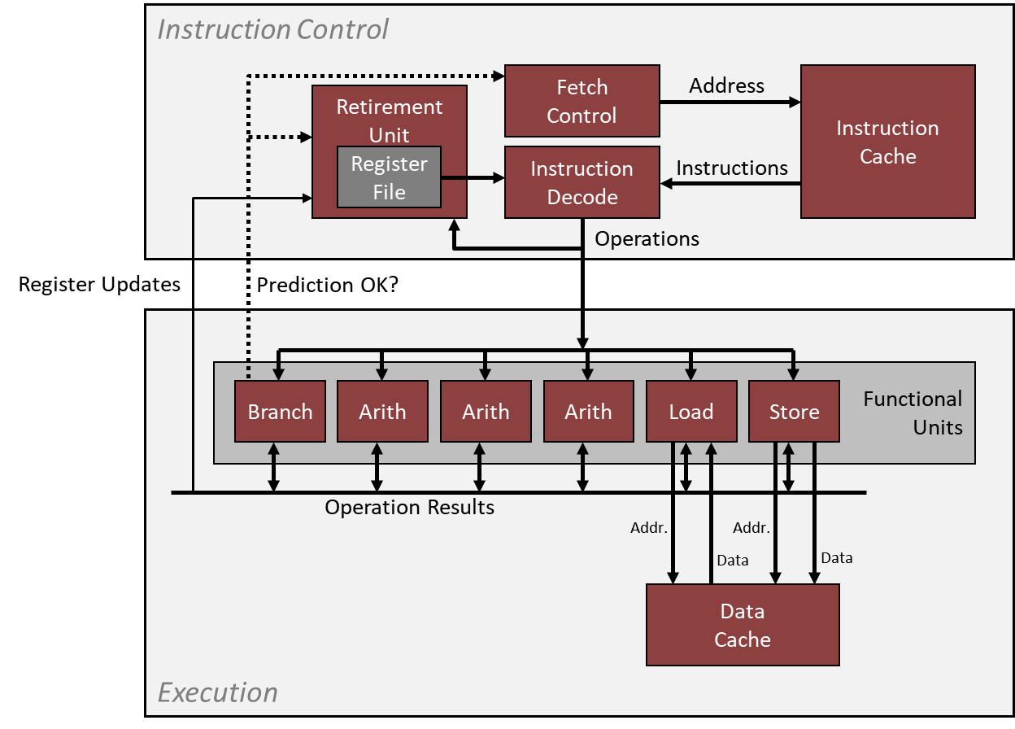
Example: The Intel Haswell CPU – aspects that are ILP relevant
Haswell: 8 Total Functional Units
Multiple instructions can execute in parallel
2 load, with address computation
1 store, with address computation
4 integer ops (doing address arithmetic too – explains why you have more)
2 FP multiply
1 FP add
1 FP divide
Some instructions take > 1 cycle, but can be pipelined
Instruction Latency, cycles Cycles/Issue
Load / Store 4 1
Integer Multiply 3 1
Integer Add 1 1
Integer/Long Divide 3-30 3-30
Single/Double FP Multiply 5 1
Single/Double FP Add 3 1
Single/Double FP Divide 3-15 3-15
For this type of info: see Agner Fog's optimization manual (part of “ME759 assigned reading” list)
[15-213 @ CMU]$→$

Slide 18
x86-64 Compilation of combine4 function
Inner Loop (Case: Integer Multiply)
.L519: # Loop:
imull (%rax,%rdx,4), %ecx # t = t * d[i]
addq $1, %rdx # i++
cmpq %rdx, %rbp # Compare length:i
jg .L519 # If >, goto Loop
Method | Integer |  | Double FP
Operation | add | mult | add | mult
combine4 | 1.27 | 3.01 | 3.01 | 5.01
Latency Bound | 1.00 | 3.00 | 3.00 | 5.00
[15-213 @ CMU]$→$

Slide 19

combine4 = Serial Computation
Assume OP $≡$ multiplication ($∗$)
1
d₀
Computation, assume length=8:
((((((((1 * d[0]) * d[1]) * d[2]) * d[3]) * d[4]) * d[5]) * d[6]) * d[7])
You have sequential dependence
Performance: determined by latency of OP
*
d₁
*
d₂
*
d₃
*
d₄
*
d₅
*
d₆
*
d₇
*
[15-213 @ CMU]$→$

Slide 20
First trick: Loop Unrolling (2x1)
void unroll2a_combine(vec_ptr v, data_t *dest) {
int length = vec_length(v);
int limit = length - 1;
data_t *d = get_vec_start(v);
data_t x = IDENT;
int i;
// Combine 2 elements at a time
for (i = 0; i < limit; i += 2) {
x = (x OP d[i]) OP d[i + 1];
}
// Finish any remaining elements
for (; i < length; i++) {
x = x OP d[i];
}
*dest = x;
}
Perform 2x more useful work per iteration
[15-213 @ CMU]$→$

Slide 21
Effect of Loop Unrolling
Method | Integer |  | Double FP
Operation | add | mult | add | mult
combine4 | 1.27 | 3.01 | 3.01 | 5.01
unroll2a | 1.01 | 3.01 | 3.01 | 5.01
Latency Bound | 1.00 | 3.00 | 3.00 | 5.00
Helps integer add
Achieves latency bound
Others don’t improve. Why?
Still sequential dependency
x = (x OP d[i]) OP d[i+1];
[15-213 @ CMU]$→$

Slide 22
Loop Unrolling with Reassociation (2x1a)
void unroll2aa_combine(vec_ptr v, data_t *dest) {
int length = vec_length(v);
int limit = length - 1;
data_t *d = get_vec_start(v);
data_t x = IDENT;
int i;
/* Combine 2 elements at a time */
for (i = 0; i < limit; i += 2) {
x = x OP(d[i] OP d[i + 1]);
}
/* Finish any remaining elements */
for (; i < length; i++) {
x = x OP d[i];
}
*dest = x;
}
Compare to before
x = (x OP d[i]) OP d[i+1];
Can this change the result of the computation?
Yes, for FP. Why?
[15-213 @ CMU]$→$

Slide 23
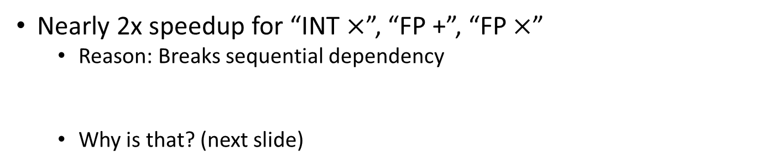
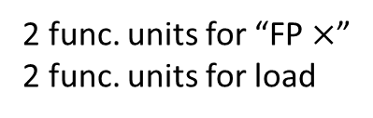
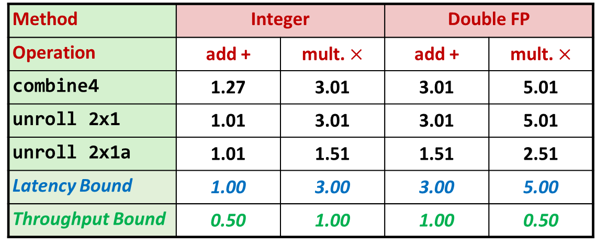
Effect of Reassociation
Method | Integer |  | Double FP
Operation | add + | mult. $×$ | add + | mult. $×$
combine4 | 1.27 | 3.01 | 3.01 | 5.01
unroll 2x1 | 1.01 | 3.01 | 3.01 | 5.01
unroll 2x1a | 1.01 | 1.51 | 1.51 | 2.51
Latency Bound | 1.00 | 3.00 | 3.00 | 5.00
Throughput Bound | 0.50 | 1.00 | 1.00 | 0.50
4 func. units for “INT +”
2 func. units for load
2 func. units for “FP $×$”
2 func. units for load
Nearly 2x speedup for “INT $×$”, “FP +”, “FP $×$”
Reason: Breaks sequential dependency
Why is that? (next slide)
x = x OP (d[i] OP d[i+1]);
[15-213 @ CMU]$→$

Slide 24
Reassociated Computation
x = x OP (d[i] OP d[i+1]);
What changed:
Ops in the next iteration can be started early (no dependency)
Prefetching kicks in
Overall Performance
N elements, D cycles latency/op
(N/2+1)*D cycles: CPE = D/2
d₀
d₁
*
d₂
d₃
1
*
d₄
d₅
*
*
d₆
d₇
*
*
*
*
[15-213 @ CMU]$→$

Slide 25
Loop Unrolling with Separate Accumulators (2x2)
void unroll2a_combine(vec_ptr v, data_t *dest) {
long length = vec_length(v);
long limit = length - 1;
data_t *d = get_vec_start(v);
data_t x0 = IDENT;
data_t x1 = IDENT;
long i;
// Combine 2 elements at a time
for (i = 0; i < limit; i += 2) {
x0 = x0 OP d[i];
x1 = x1 OP d[i + 1];
}
// Finish any remaining elements
for (; i < length; i++) {
x0 = x0 OP d[i];
}
*dest = x0 OP x1;
}
Different form of reassociation
[15-213 @ CMU]$→$

Slide 26
Effect of Separate Accumulators
Method | Integer |  | Double FP
Operation | Add | Mult | Add | Mult
Combine4 | 1.27 | 3.01 | 3.01 | 5.01
Unroll 2x1 | 1.01 | 3.01 | 3.01 | 5.01
Unroll 2x1a | 1.01 | 1.51 | 1.51 | 2.51
Unroll 2x2 | 0.81 | 1.51 | 1.51 | 2.51
Latency Bound | 1.00 | 3.00 | 3.00 | 5.00
Throughput Bound | 0.50 | 1.00 | 1.00 | 0.50
“INT +” makes use of two load units
2x speedup (over unroll2) for “INT *”, “FP +”, “FP *”
x0 = x0 OP d[i];
x1 = x1 OP d[i+1];
[15-213 @ CMU]$→$

Slide 27
Separate Accumulators
x0 = x0 OP d[i];
x1 = x1 OP d[i+1];
What changed:
Two independent “streams” of operations
Overall Performance
N elements, D cycles latency/op
Should be (N/2+1)*D cycles: CPE = D/2
CPE matches prediction!
1
d₀
1
d₁
*
d₂
*
d₃
*
d₄
*
d₅
*
d₆
*
d₇
*
*
What Now?
*
[15-213 @ CMU]$→$

Slide 28
Unrolling & Accumulating
Idea
Can unroll to any degree L
Can accumulate K results in parallel
L must be multiple of K
Limitations
Diminishing returns
Cannot go beyond throughput limitations of execution units
Large overhead for short lengths
Finish off iterations sequentially
[15-213 @ CMU]$→$

Slide 29
Unrolling & Accumulating: Floating Point Multiplication
Case
Intel Haswell
Double FP Multiplication
Latency bound: 5.00. Throughput bound: 0.50
FP * | Unrolling Factor L
K | 1 | 2 | 3 | 4 | 6 | 8 | 10 | 12
1 | 5.01 | 5.01 | 5.01 | 5.01 | 5.01 | 5.01 | 5.01
2 |  | 2.51 |  | 2.51 |  | 2.51
3 |  |  | 1.67
4 |  |  |  | 1.25 |  | 1.26
6 |  |  |  |  | 0.84 |  |  | 0.88
8 |  |  |  |  |  | 0.63
10 |  |  |  |  |  |  | 0.51
12 |  |  |  |  |  |  |  | 0.52
Accumulators
[15-213 @ CMU]$→$

Slide 30
Unrolling & Accumulating: Integer Addition
Case
Intel Haswell
Integer addition
Latency bound: 1.00. Throughput bound: 0.50
FP * | Unrolling Factor L
K | 1 | 2 | 3 | 4 | 6 | 8 | 10 | 12
1 | 1.27 | 1.01 | 1.01 | 1.01 | 1.01 | 1.01 | 1.01
2 |  | 0.81 |  | 0.69 |  | 0.54
3 |  |  | 0.74
4 |  |  |  | 0.69 |  | 1.24
6 |  |  |  |  | 0.56 |  |  | 0.56
8 |  |  |  |  |  | 0.54
10 |  |  |  |  |  |  | 0.54
12 |  |  |  |  |  |  |  | 0.56
Accumulators
[15-213 @ CMU]$→$

Slide 31
Achievable Performance
Method | Integer |  | Double FP
Operation | Add | Mult | Add | Mult
Best | 0.54 | 1.01 | 1.01 | 0.52
Latency Bound | 1.00 | 3.00 | 3.00 | 5.00
Throughput Bound | 0.50 | 1.00 | 1.00 | 0.50
Limited only by throughput of functional units
Up to 42X improvement over original, un-optimized code
[15-213 @ CMU]$→$

Slide 32
Vector instructions
Basic idea: Use fat registers to perform the same operation on all variables stored in register
X86 has, for instance, 512 bit-wide registers
Technology called AVX512
Since chip in this example is Haswell, it only has 256-bit registers
Technology called AVX2

Slide 33
Programming with AVX2, YMM Registers related
16 total, each 32 bytes
What can you do with them?
Store 8 32-bit integers:
Store 8 single-precision floats:
Store 4 double-precision floats:
Store 1 single-precision float but then waste bits:
Store 1 double-precision float but then waste bits:

Slide 34
SIMD Operations, with AVX2
SIMD Operations: Single Precision
SIMD Operations: Double Precision
vaddsd %ymm0, %ymm1, %ymm1
%ymm0
+
+
+
+
+
+
+
+
%ymm1
vaddpd %ymm0, %ymm1, %ymm1
%ymm0
+
+
+
+
%ymm1
[15-213 @ CMU]$→$

Slide 35
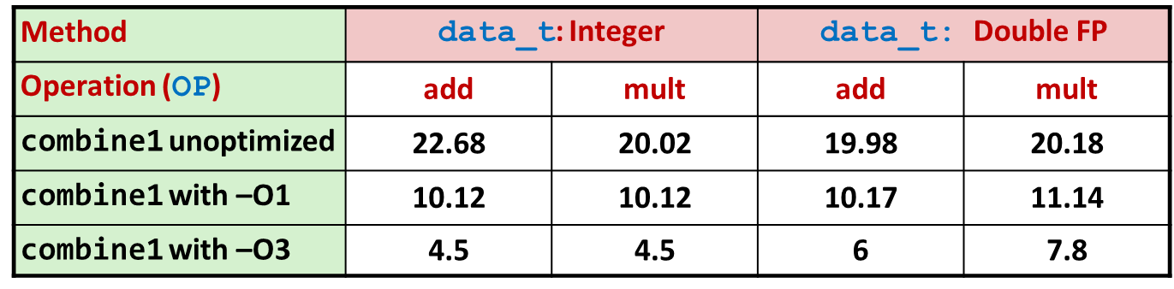
Using Vector Instructions
Method | Integer |  | Double FP
Operation | add | mult | add | mult
Scalar Best | 0.54 | 1.01 | 1.01 | 0.52
Vector Best | 0.06 | 0.24 | 0.25 | 0.16
Latency Bound | 0.50 | 3.00 | 3.00 | 5.00
Throughput Bound | 0.50 | 1.00 | 1.00 | 0.50
Vec Throughput Bound | 0.06 | 0.12 | 0.25 | 0.12
This is where we are now
Additional speedup owing to use of AVX Instructions
Parallel operations on multiple data elements
The “mips” in OpenMP
This is where we started
[15-213 @ CMU]$→$

Slide 36
Supplemental Material: Branch Prediction (another ILP trick)
Challenge
Instruction Control Unit must work ahead of Execution Unit to generate enough operations to keep EU busy
When encounters conditional branch, cannot reliably determine where to continue fetching
404663: mov $0x0,%eax
404668: cmp (%rdi),%rsi
40466b: jge 404685
40466d: mov 0x8(%rdi),%rax
. . .
404685: repz retq
Executing
How to continue?
[15-213 @ CMU]$→$

Slide 37
Modern CPU Design
Instruction Control
Fetch
Control
Address
Instruction
Cache
Retirement
Unit
Register
File
Instruction
Decode
Instructions
Operations
Register Updates
Prediction OK?
Execution
Functional
Units
Branch
Arith
Arith
Arith
Load
Store
Operation Results
Addr.
Addr.
Data
Data
Data
Cache
[15-213 @ CMU]$→$

Slide 38
Branch Outcomes
When encounter conditional branch, cannot determine where to continue fetching
Branch Taken: Transfer control to branch target
Branch Not-Taken: Continue with next instruction in sequence
Cannot resolve until outcome determined by branch/integer unit
404663: mov $0x0,%eax
404668: cmp (%rdi),%rsi
40466b: jge 404685
40466d: mov 0x8(%rdi),%rax
. . .
404685: repz retq
Branch Not-Taken
Branch Taken
[15-213 @ CMU]$→$

Slide 39
Branch Prediction
Idea
Guess which way branch will go
Begin executing instructions at predicted position
But don’t actually modify register or memory data (draws on RAT & ROB, see later)
404663: mov $0x0,%eax
404668: cmp (%rdi),%rsi
40466b: jge 404685
40466d: mov 0x8(%rdi),%rax
. . .
404685: repz retq
Predict Taken
Begin
Execution
[15-213 @ CMU]$→$

Slide 40
Branch Prediction Through Loop
401029: vmulsd (%rdx),%xmm0,%xmm0
40102d: add $0x8,%rdx
401031: cmp %rax,%rdx
401034: jne 401029
Assume
vector length = 100
i = 98
Predict Taken (OK)
401029: vmulsd (%rdx),%xmm0,%xmm0
40102d: add $0x8,%rdx
401031: cmp %rax,%rdx
401034: jne 401029
i = 99
Predict Taken
(Oops)
401029: vmulsd (%rdx),%xmm0,%xmm0
40102d: add $0x8,%rdx
401031: cmp %rax,%rdx
401034: jne 401029
Read invalid location
Executed
i = 100
401029: vmulsd (%rdx),%xmm0,%xmm0
40102d: add $0x8,%rdx
401031: cmp %rax,%rdx
401034: jne 401029
Fetched
i = 101
[15-213 @ CMU]$→$

Slide 41
Branch Misprediction Invalidation
401029: vmulsd (%rdx),%xmm0,%xmm0
40102d: add $0x8,%rdx
401031: cmp %rax,%rdx
401034: jne 401029
Assume
vector length = 100
i = 98
Predict Taken (OK)
401029: vmulsd (%rdx),%xmm0,%xmm0
40102d: add $0x8,%rdx
401031: cmp %rax,%rdx
401034: jne 401029
i = 99
Predict Taken
(Oops)
401029: vmulsd (%rdx),%xmm0,%xmm0
40102d: add $0x8,%rdx
401031: cmp %rax,%rdx
401034: jne 401029
i = 100
Invalidate
401029: vmulsd (%rdx),%xmm0,%xmm0
40102d: add $0x8,%rdx
401031: cmp %rax,%rdx
401034: jne 401029
i = 101
[15-213 @ CMU]$→$

Slide 42
Branch Misprediction Recovery
401029: vmulsd (%rdx),%xmm0,%xmm0
40102d: add $0x8,%rdx
401031: cmp %rax,%rdx
401034: jne 401029
401036: jmp 401040
. . .
401040: vmovsd %xmm0,(%r12)
i = 99
Definitely not taken
Reload
Pipeline
Performance Cost
Multiple clock cycles on modern processor
Can be a major performance limiter
[15-213 @ CMU]$→$

Slide 43
Branch Prediction Numbers
Default behavior:
Backwards branches are often loops so predict taken
Forwards branches are often if so predict not taken
Predictors average better than 95% accuracy
Most branches are already predictable.
Bonus material:
http://stackoverflow.com/questions/11227809/why-is-processing-a-sorted-array-faster-than-an-unsorted-array
[15-213 @ CMU]$→$

Slide 44
Short trip: actors, the “speculative execution” trick [it’s tricky]
“instruction issue phase” vs. “instruction retirement phase”: two different animals
ROB: reorder buffer
At issue time, an instruction is assigned an entry at the tail of the ROB. It’s there while in flight, before being committed
RAT: register alias table
RAT needed because of “register renaming”, which is a technique that abstracts logical registers from physical registers
Every logical register has a set of physical registers associated with it
The physical registers are opaque and cannot be referenced directly but only via the canonical names
The interplay between ROB and RAT allows an unwinding of the instructions without compromising the state of the program (since things were not committed yet)
Resources: see here and here, it takes 7 mins total.

Slide 45
Looking back at examples, what we did to improve performance
Used good compiler and the right flags
Helped the compiler get optimization going (use “restrict” keyword on pointer arguments)
Exploited instruction-level parallelism

Slide 46
Parallel Computing with the Message Passing Interface (MPI)
Notes:
DAN: NEXT TIME YOU DO MPI, GO READ https://computing.llnl.gov/tutorials/mpi/

Slide 47
Acknowledgments
Parts of the MPI material covered draws on slides made available by Irish Centre for High-End Computing (ICHEC)
The ICHEC material was based on the MPI course developed by Rolf Rabenseifner at the High-Performance Computing-Center Stuttgart (HLRS), University of Stuttgart in collaboration with the EPCC Training and Education Centre, Edinburgh Parallel Computing Centre, University of Edinburgh
Slides have been changed, which probably explains any inaccuracies in the material

Slide 48
ME759: where we are right now
Behind us: OpenMP & CUDA
Commodity parallel computing (eight cores, or one GPU, etc.)
Next segment: the non-commodity parallel computing
Reliance on supercomputers
We will focus on the Message Passing Interface (MPI) standard
MPI: The software environment that makes supercomputers tick
MPI is for supercomputers what CUDA is for the GPU and OpenMP for the multi-core chip

Slide 49
Opportunities for Efficiency Gains
Cluster (distributed mem.)
Group of nodes communicate through fast interconnect
MPI, Charm++, Chapel
Multi-Socket Node
Group of CPUs on the same node, talk through main mem.
OpenMP, MPI
Acceleration (GPU/Phi)
Compute devices accelerating parallel computation on one node
CUDA, OpenCL, OpenMP
Multi-Core Processor
Communication through shared caches and main mem.
OpenMP, TBB, pthreads
Vectorization
Higher operation throughput via special/fat registers
AVX, SSE
Pipelining
Sequence of instruction sharing functional units
Assembly
Superscalar
Non-sequence instructions sharing functional units
Assembly
We have full control →
We have little to no control →
What is left at this point →
Any ILP issues that we can address?
Hitting the cache?
Any opportunities for vectorization?
Do the threads work together harmoniously?
Any NUMA issues to be aware of?
Communication/synchronization reduced as much as possible?

Slide 50
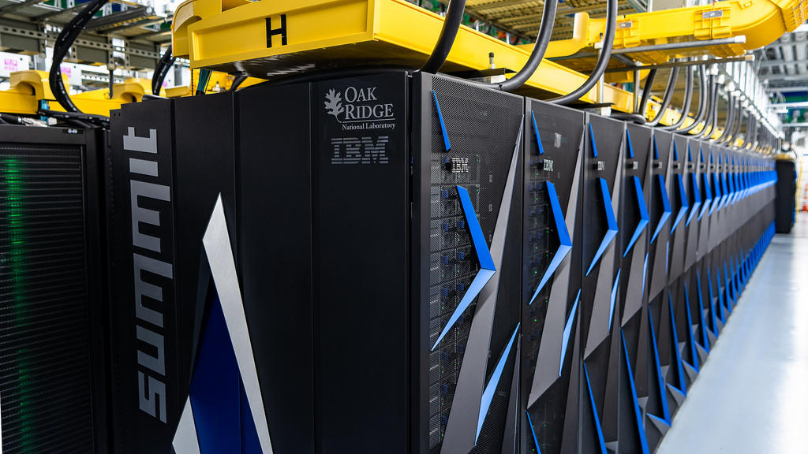
Supercomputers, example

Slide 51
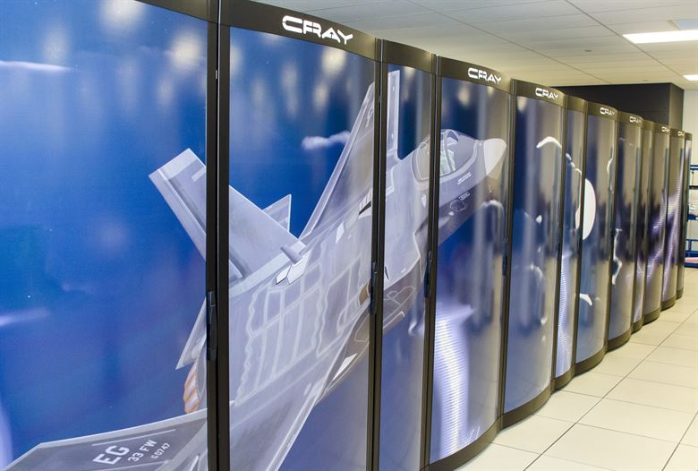
Supercomputers, examples ($20 million and such)

Slide 52
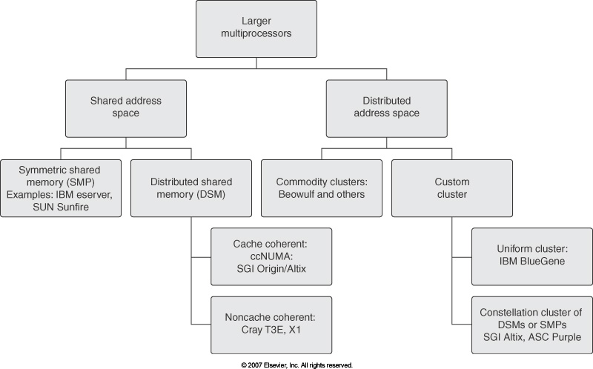
Overview of Large Multiprocessor Hardware Configurations (“supercomputers”)
Euler
Courtesy of Elsevier, Computer Architecture, Hennessey and Patterson, fourth edition
Notes:
For the Microprocessor this is measured in MIPS (million instructions per second). Many reported IPS values have represented "peak" execution rates on artificial instruction sequences with few branches, whereas realistic workloads typically lead to significantly lower IPS values.

Slide 53
Nomenclature Issues
Shared address space: when you invoke address “0x0043fc6f” on one machine and then invoke “0x0043fc6f” on a different machine they actually point to the same global memory space
Issues: memory coherence
Fix: software-based or hardware-based
Distributed address space: the opposite of the above
Symmetric Multiprocessor (SMP): you have one machine that shares amongst all its processing units a certain amount of memory (same address space)
Mechanisms should be in place to prevent data hazards (RAW, WAR, WAW). Raises the issue of memory coherence
Distributed shared memory (DSM) – aka distributed global address space (DGAS)
Although physically memory is distributed, it shows as one uniform memory
Memory latency is highly unpredictable

Slide 54
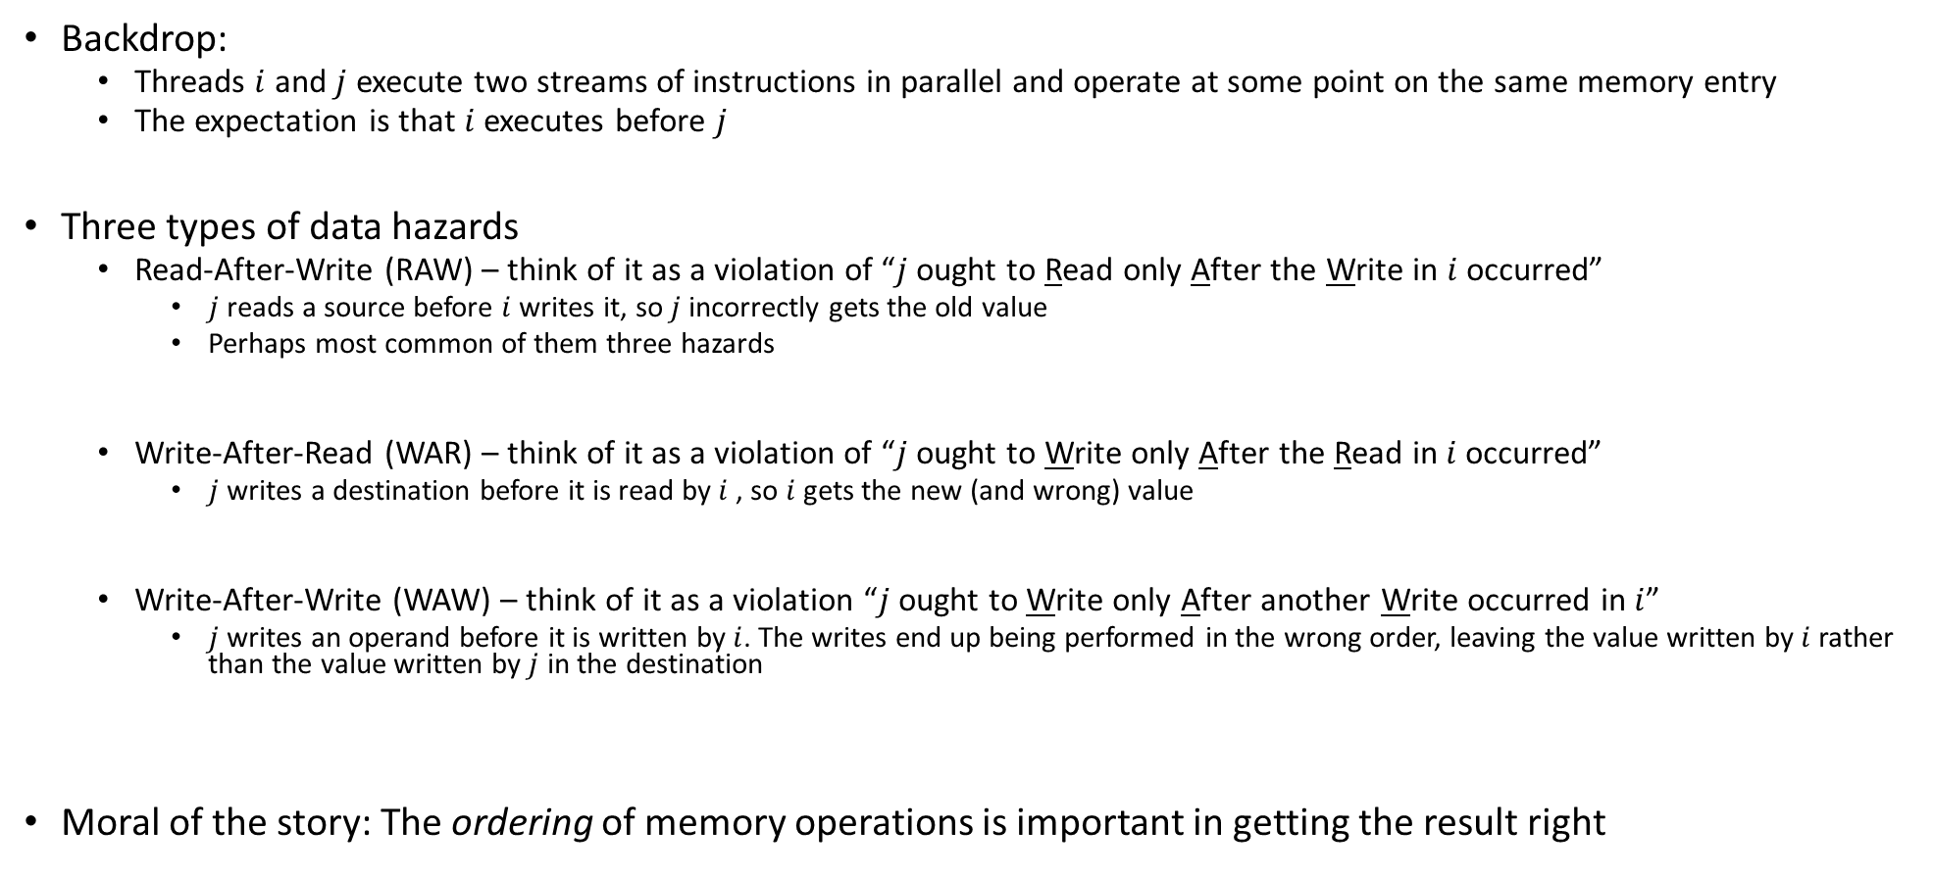
Data Hazards in Parallel Computing
Backdrop:
Threads $i$ and $j$ execute two streams of instructions in parallel and operate at some point on the same memory entry
The expectation is that $i$ executes before $j$
Three types of data hazards
Read-After-Write (RAW) – think of it as a violation of “$j$ ought to Read only After the Write in $i$ occurred”
$j$ reads a source before $i$ writes it, so $j$ incorrectly gets the old value
Perhaps most common of them three hazards
Write-After-Read (WAR) – think of it as a violation of “$j$ ought to Write only After the Read in $i$ occurred”
$j$ writes a destination before it is read by $i$ , so $i$ gets the new (and wrong) value
Write-After-Write (WAW) – think of it as a violation “$j$ ought to Write only After another Write occurred in $i$”
$j$ writes an operand before it is written by $i$. The writes end up being performed in the wrong order, leaving the value written by $i$ rather than the value written by $j$ in the destination
Moral of the story: The ordering of memory operations is important in getting the result right

Slide 55
Example
Distributed-memory multiprocessor (MP) architecture
Euler, for instance
Courtesy of Elsevier, Computer Architecture, Hennessey and Patterson, fifth edition
55
Notes:
Hammad – Updated Figure from fifth edition

Slide 56
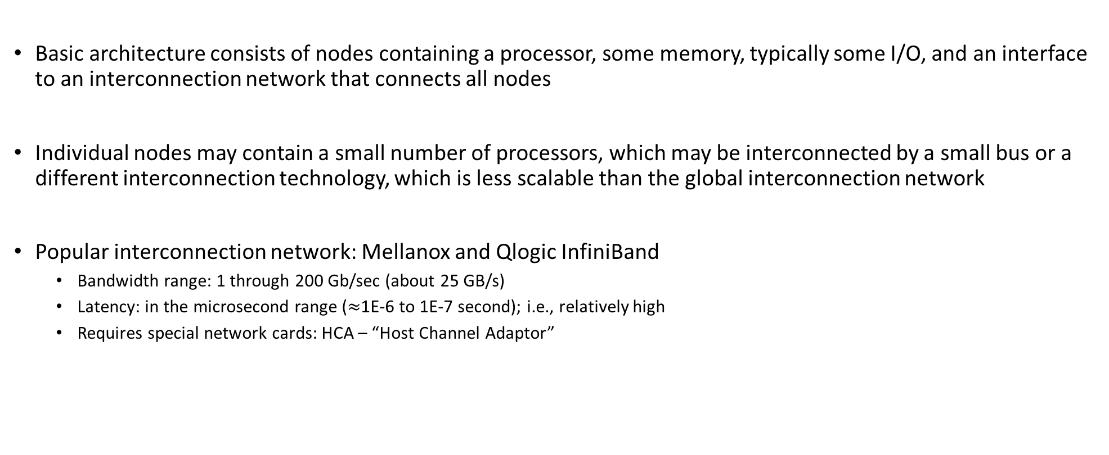
Comments, distributed-memory multiprocessor architecture
Basic architecture consists of nodes containing a processor, some memory, typically some I/O, and an interface to an interconnection network that connects all nodes
Individual nodes may contain a small number of processors, which may be interconnected by a small bus or a different interconnection technology, which is less scalable than the global interconnection network
Popular interconnection network: Mellanox and Qlogic InfiniBand
Bandwidth range: 1 through 200 Gb/sec (about 25 GB/s)
Latency: in the microsecond range ($≈$1E-6 to 1E-7 second); i.e., relatively high
Requires special network cards: HCA – “Host Channel Adaptor”

Slide 57
Examples…
Shared-Memory
Intel Xeon Scalable CPUs
56 cores per CPU Package
Up to 2 CPUs can live in a single system. That’s 112 cores.
AMD EPYC Rome
7nm manufacturing process crams up to 64 cores on a package
2 CPUs can live on a system
IBM POWER9
2 CPUs (up to 22 cores each)
NVLINK 2.0 technology allows up to 6 GPUs to access up to 1 TB of system memory
Distributed-Memory
IBM BlueGene/L
Cell (see http://users.ece.utexas.edu/~adnan/vlsi-07/hofstee-cell.ppt)
Notes:
57
Pipelining: http://arstechnica.com/articles/paedia/cpu/pipelining-2.ars

Slide 58
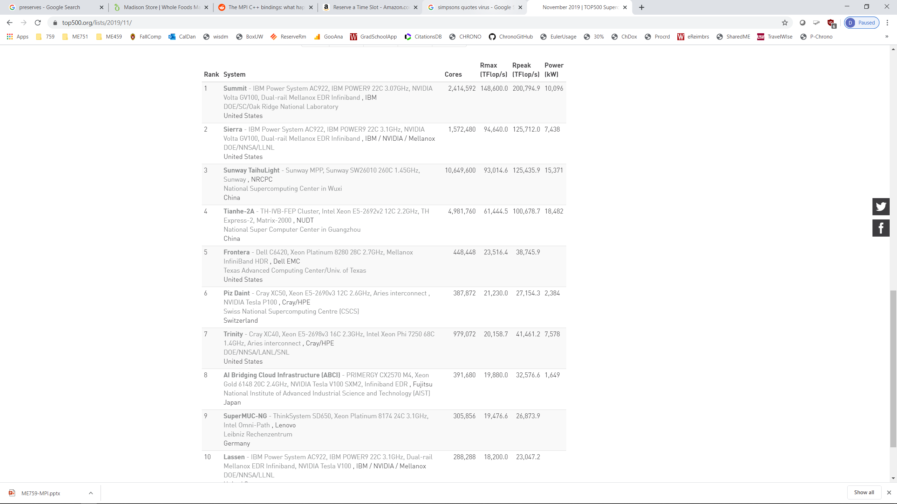
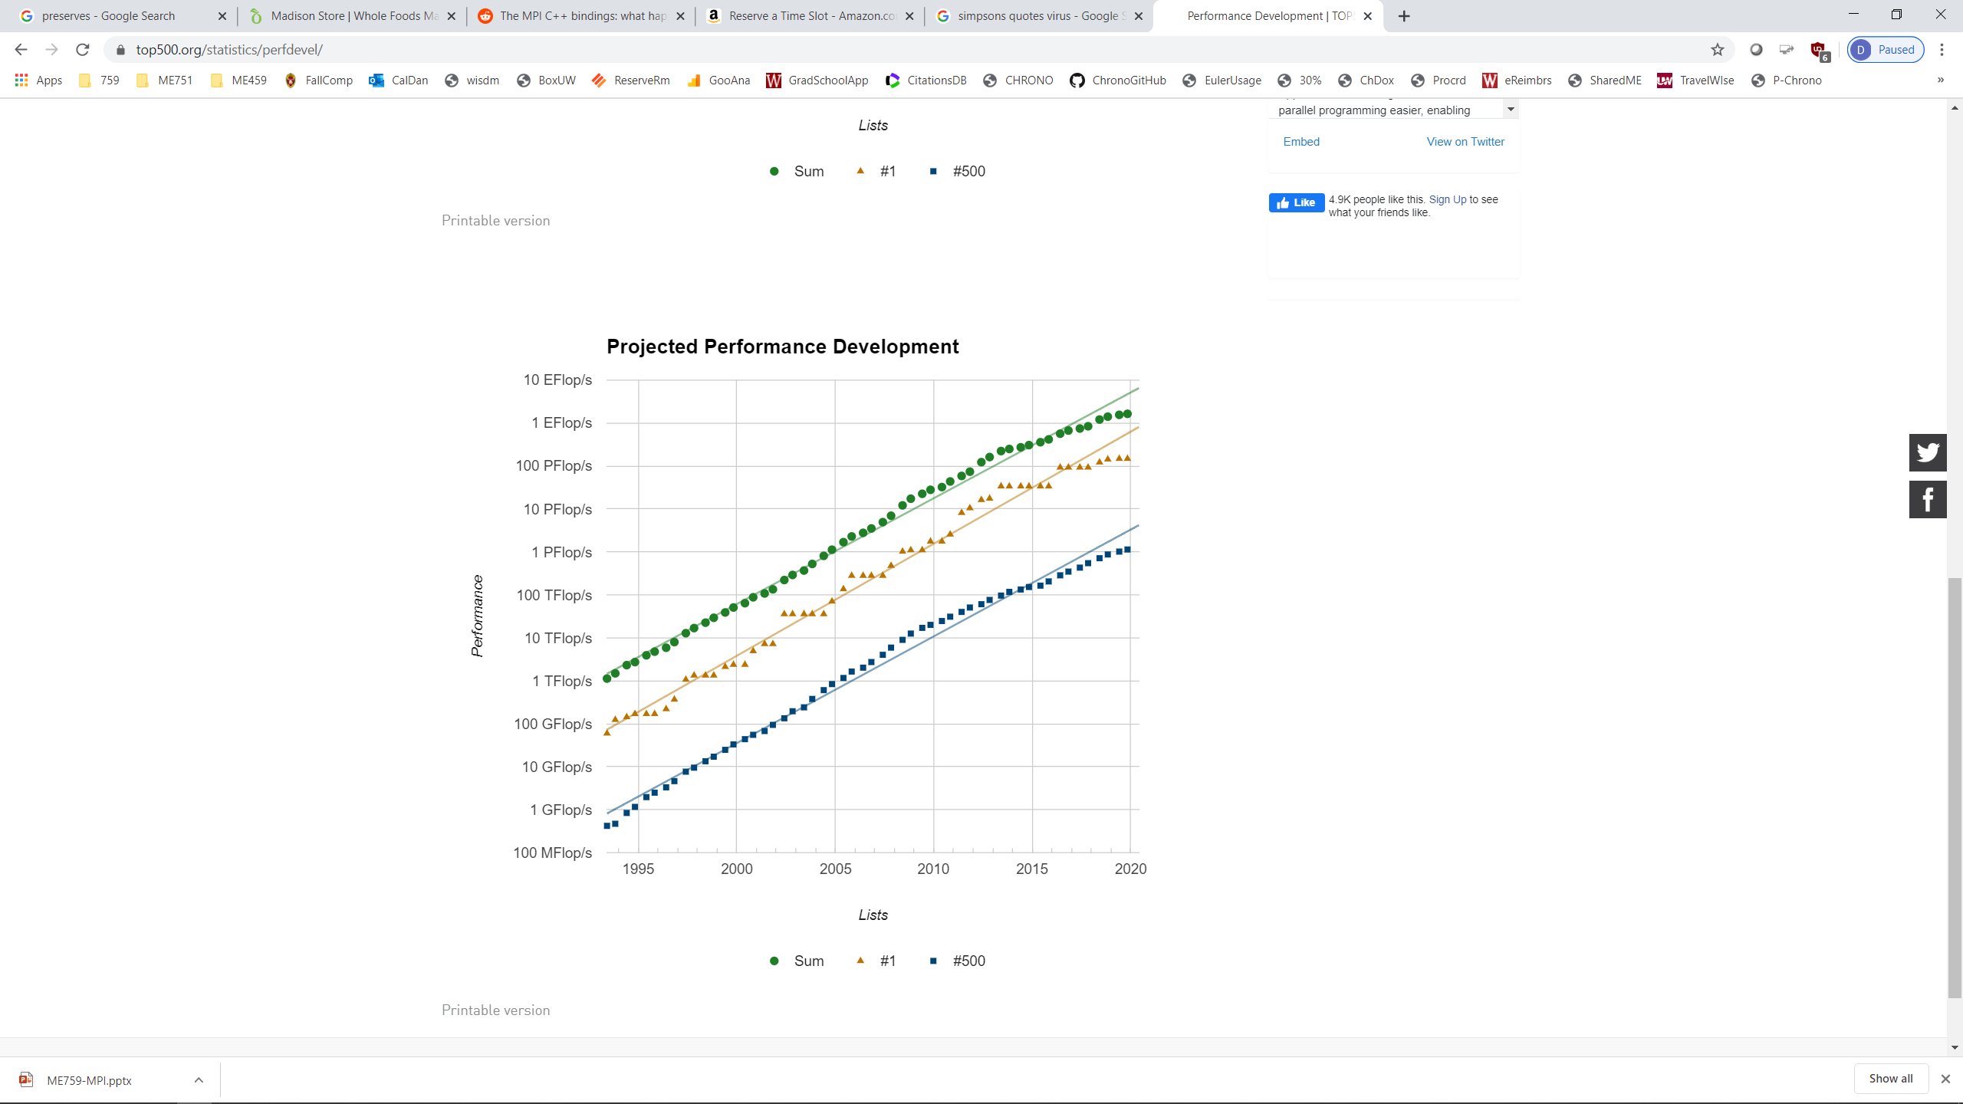
Supercomputers: Where Are We Today? [Info lifted from Top500 website: http://www.top500.org/]
Notes:
58

Slide 59

How is a supercomputer’s speed measured?
How is the speed measured to put together the Top500?
Basically reports how fast you can solve a dense linear system

Slide 60
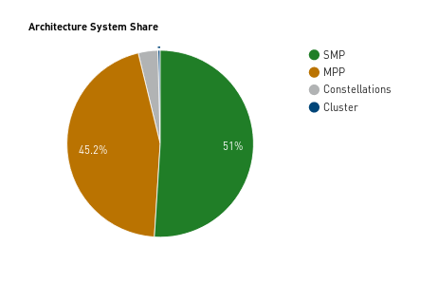
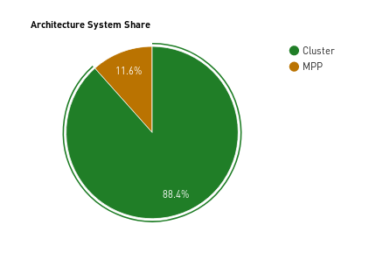
Supercomputers: Where Are We Today? [Cntd.]
1998
2018
Abbreviations/Nomenclature
MPP – Massively Parallel Processing
Constellation – subclass of cluster architecture envisioned to capitalize on data locality
60
Notes:
Hammad – Updated with newer plots
60

Slide 61
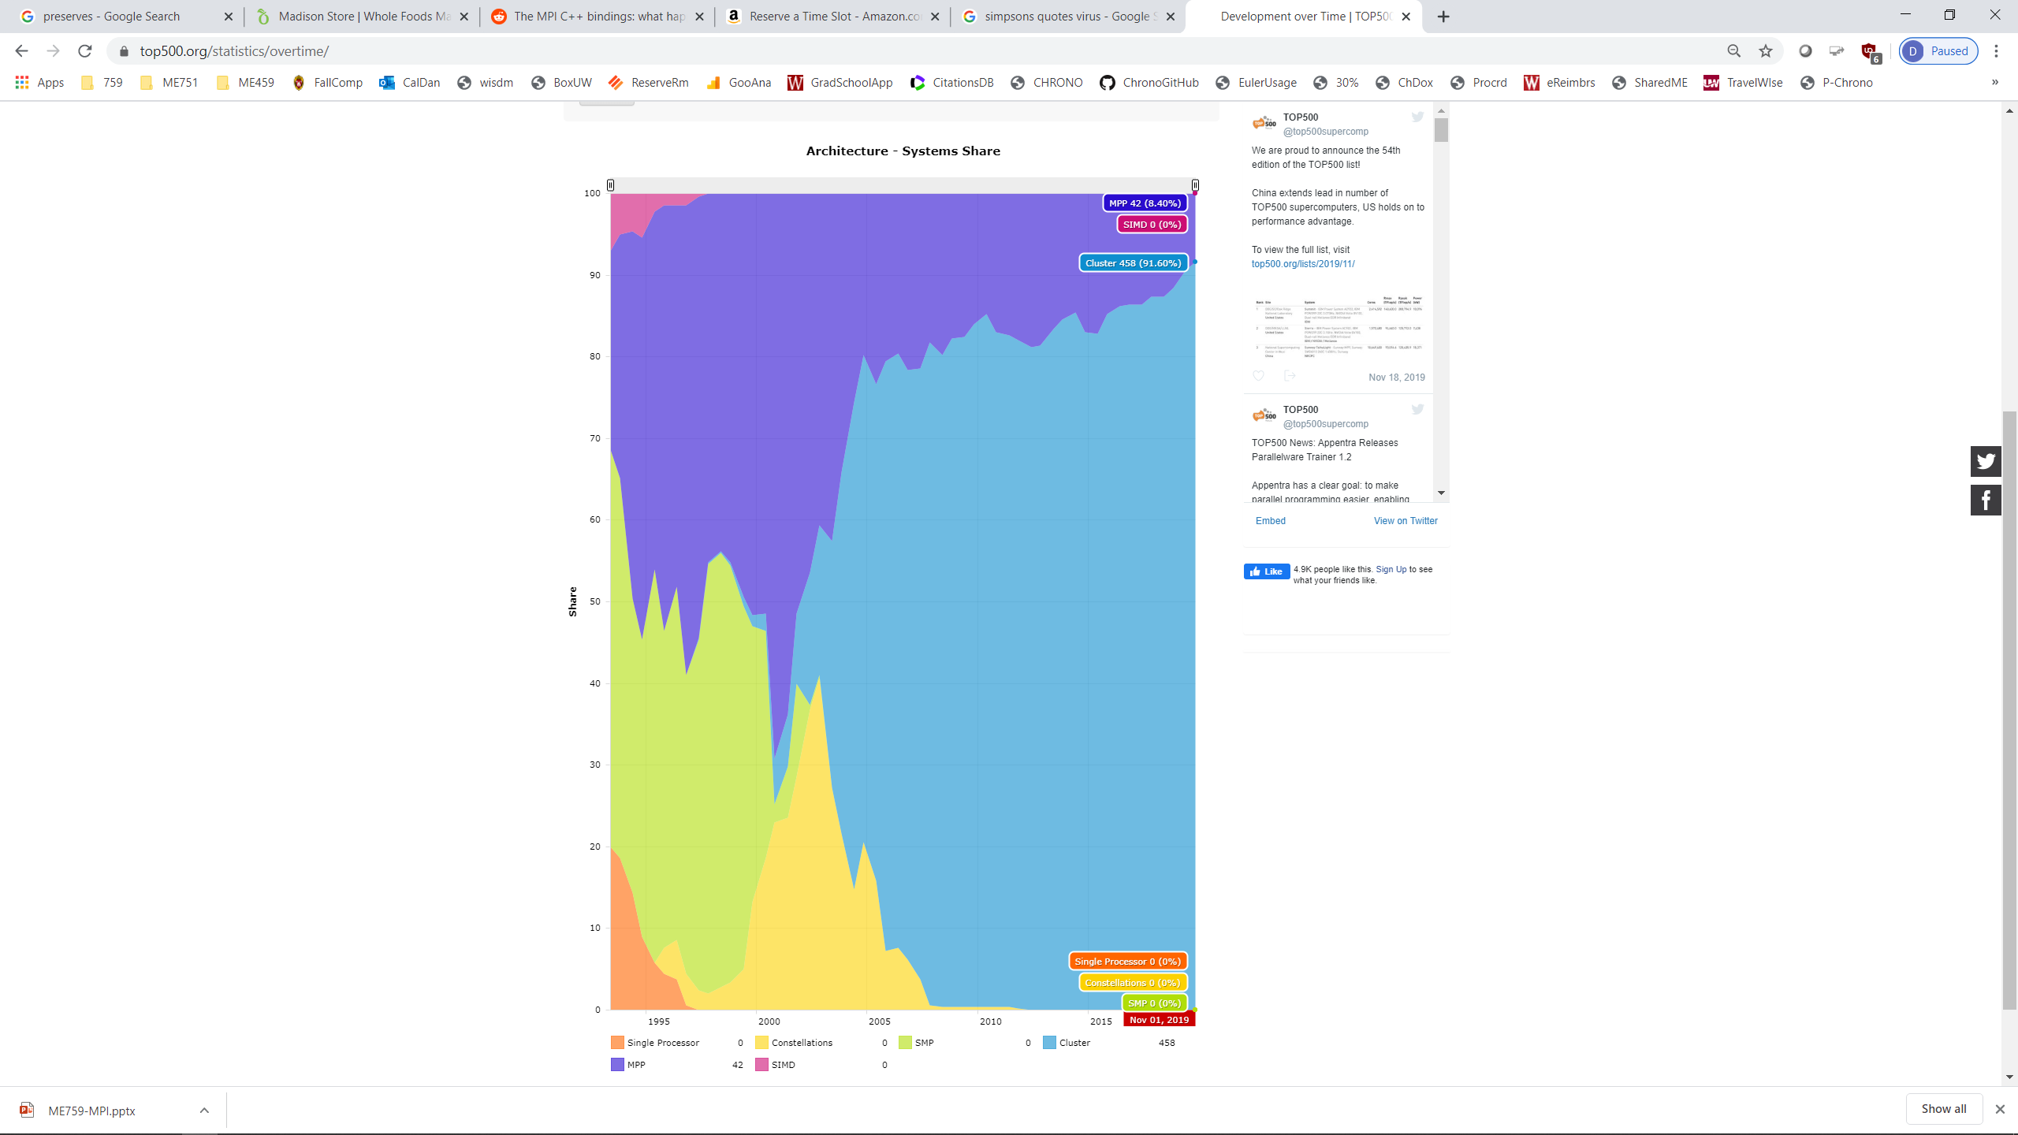
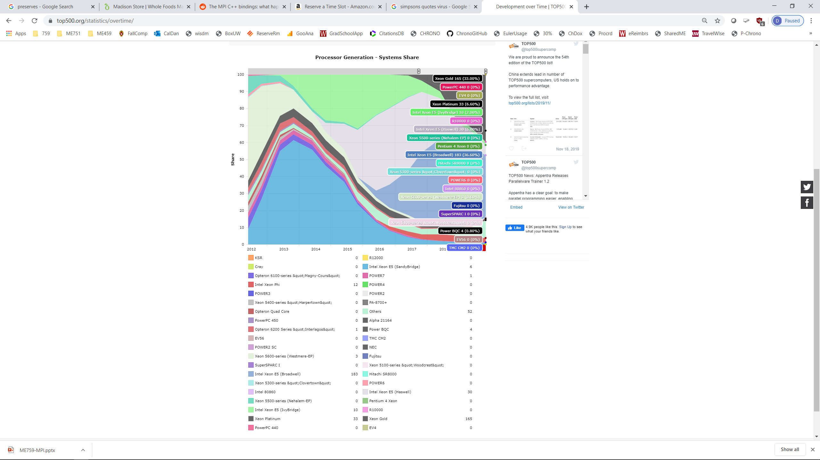
Supercomputers: Where Are We Today? [Cntd.]
Abbreviations/Nomenclature
MPP – Massively Parallel Processing
Constellation – subclass of cluster architecture envisioned to capitalize on data locality
MIPS – “Microprocessor without Interlocked Pipeline Stages”, a chip design of the MIPS Computer Systems of Sunnyvale, California
SPARC – “Scalable Processor Architecture” is a RISC instruction set architecture developed by Sun Microsystems (now Oracle) and introduced in mid-1987
Alpha - a 64-bit reduced instruction set computer (RISC) instruction set architecture developed by DEC (Digital Equipment Corporation was sold to Compaq, which was sold to HP) – adopted by Chinese chip manufacturer (see primer)
Notes:
Hammad – Updated with newer plots

Slide 62
Nomenclature: What is an MPP? How’s it different from a cluster?
MPP: A very large-scale computing system with commodity processing nodes interconnected with a custom-made high-bandwidth low-latency interconnect
A cluster is an MPP for which the manufacturer forgot to put a high-bandwidth low-latency interconnect
Memories are physically distributed
Nodes often run a microkernel
Perhaps this is a second difference, a cluster might run some rather pedestrian Linux distro
Rather blurred line between MPPs and clusters
Example:
Euler (our machine) is a cluster
An IBM BG/Q machine is an MPP (because of the interconnect)

Slide 63
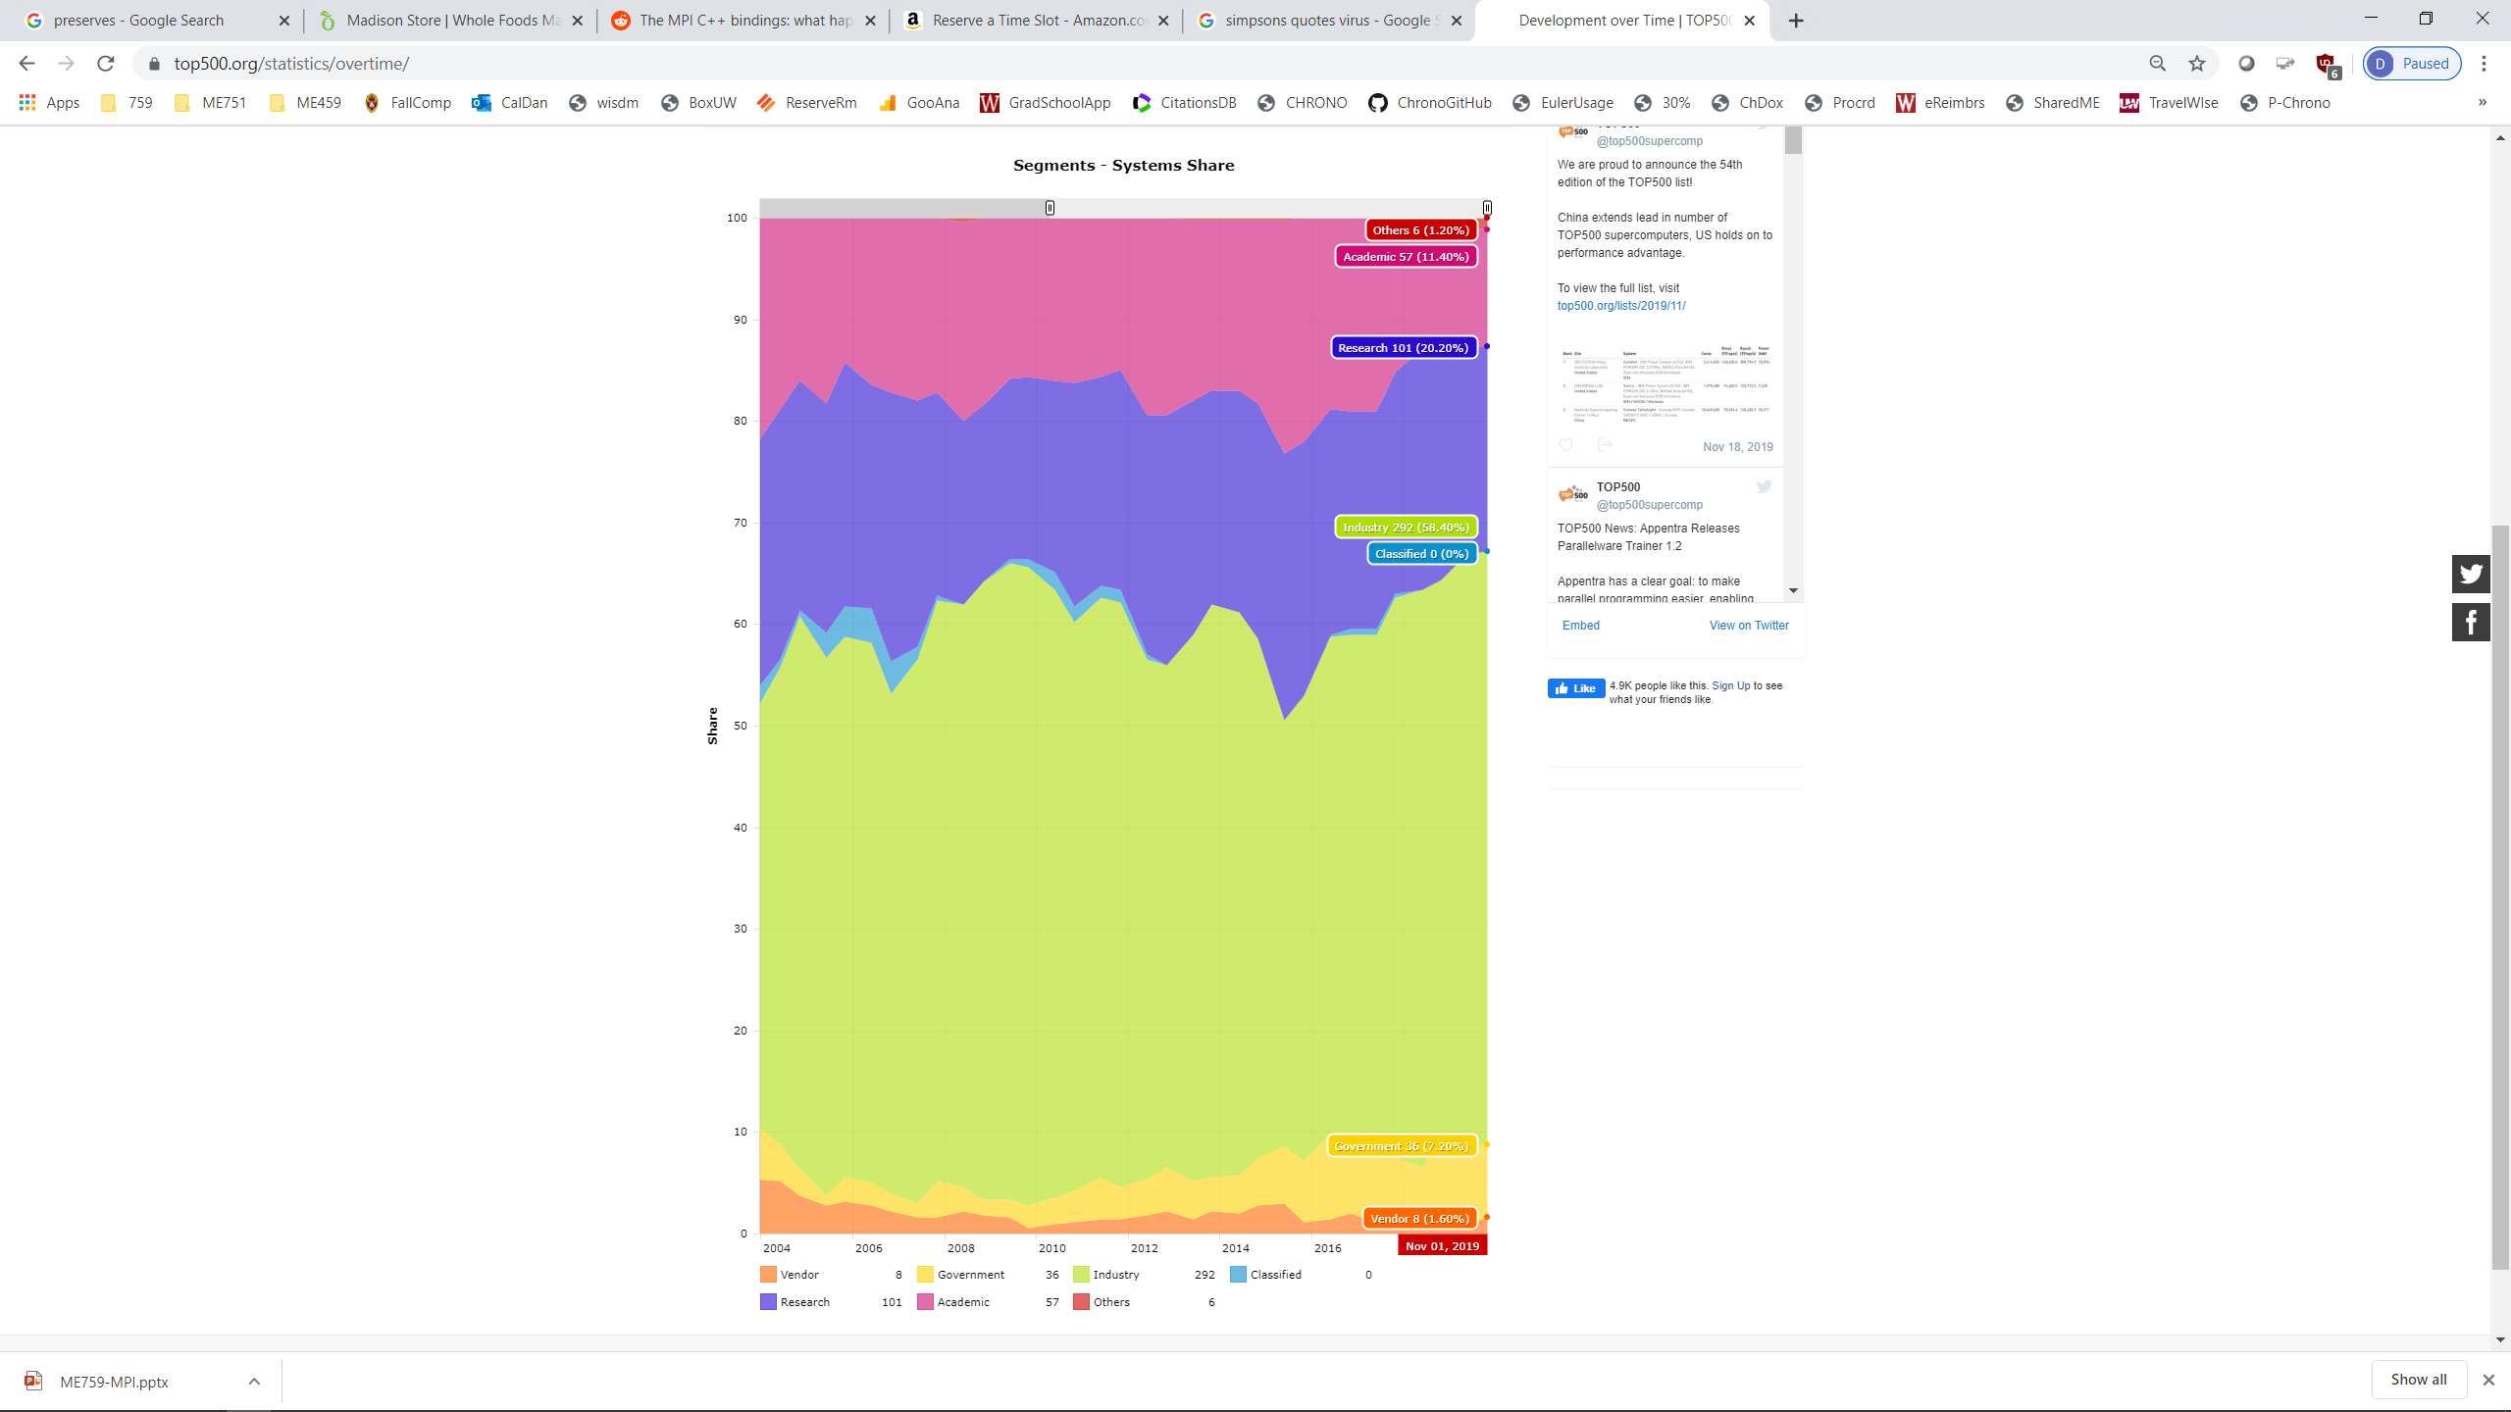
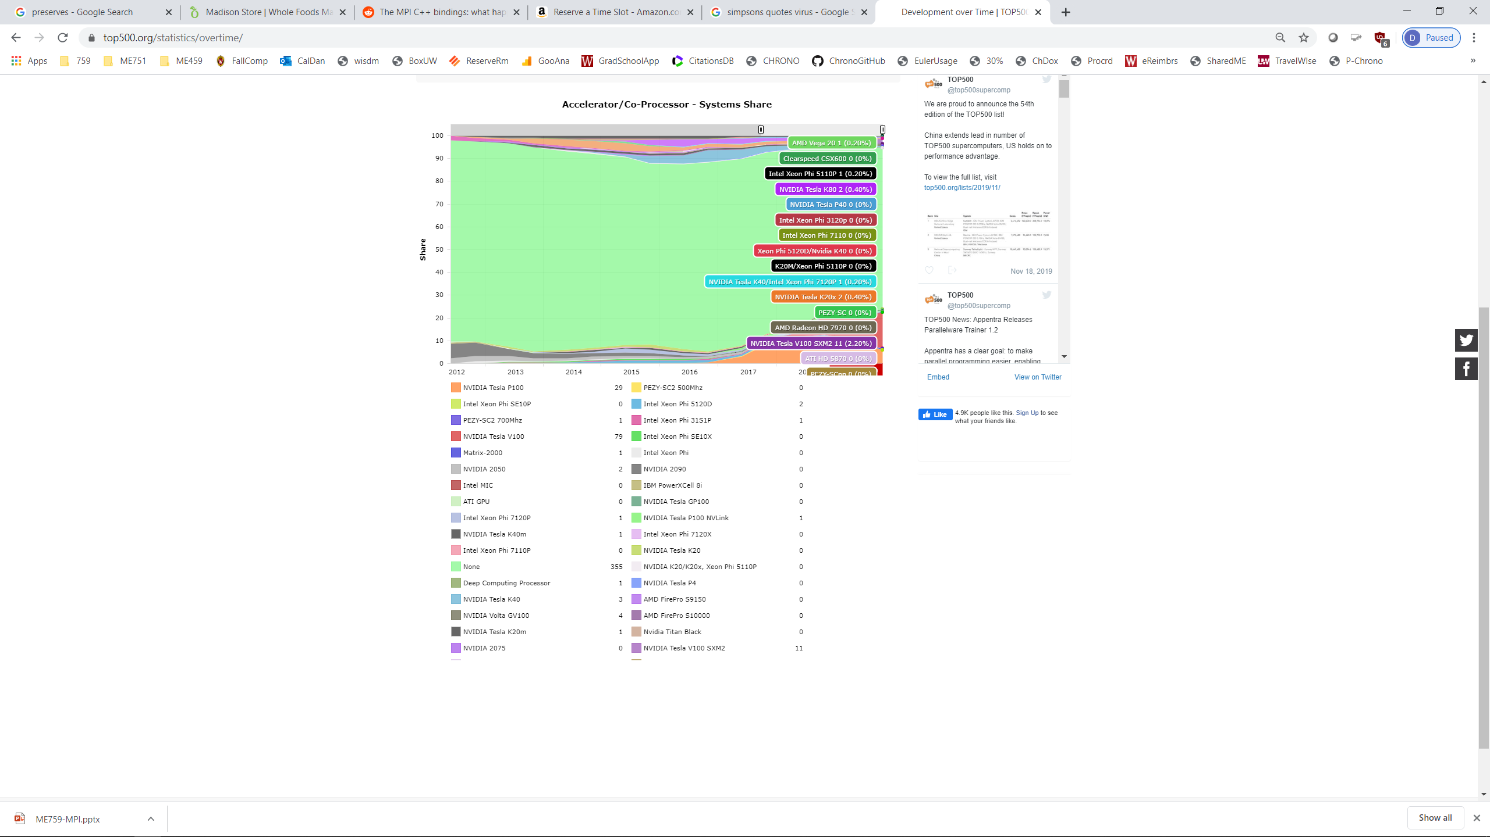
Supercomputers: Where Are We Today?[Cntd.]
Top 500: What accelerators do they use?

Slide 64
Shared Memory Hardware Systems
Memory is shared; i.e., visible to all processors and threads
Typical scenario, on a budget: one node with four CPUs, each with 16 cores
Typically one node systems; i.e., a workstation or a laptop
Example:
Symmetric Multi-Processors (SMP) – like one node of Euler
Each processor has equal access to RAM
Traditionally, this represents the hardware setup that supports OpenMP-enabled parallel computing
Two issues, with SMP-leveraging OpenMP:
Challenging applications might need more memory than available on the typical multi-core node
Solution scales poorly with system size due to cache coherence aspects
[A. Jacobs]→

Slide 65


SMS vs. Distributed Memory Systems (DMS)
Shared Memory System
CPU
CPU
CPU
$$⋯$$
CPU
Interconnect
Memory
Distributed Memory System
CPU
CPU
CPU
CPU
$$⋯$$
Memory
Memory
Memory
Memory
Interconnect

Slide 66
Distributed Memory Hardware Systems: The Virtual Memory Angle
Typically, parallelism on supercomputers accomplished by interplay between different *processes* and not threads
Consequence: each process sees its own virtual memory, there’s no overlap
More difficult to write programs for distributed memory systems since the programmer must keep track of memory usage

Slide 67
Schematic, Typical Example
Distributed-memory multiprocessor architecture (Euler, for instance)
Computer Architecture, Hennessey and Patterson, fifth edition
Notes:
Euler is of this type

Slide 68
Bandwidths in a multi-node, CPU-GPU System
Latency:
Low
GPU cores
CPU Core
Cache
80GB/s
NOTE: The width of the black lines is proportional to the bandwidth.
50-100
GB/s
900
GB/s
GPU accelerator
Latency:
Medium Low
Latency:
Pretty Low
System Memory
GPU Memory
Infiniband to Next Node
8-16 GB/s
6GB/s
Latency:
High
Latency:
Medium
This is important over the next two lectures
Notes:
68
Hammad – GPU numbers are for a Volta V100, PCI numbers are for PCIe3
Infiniband is assuming mellanox results from here: http://www.mellanox.com/page/performance_infiniband
CPU memory numbers are for a E7 8890v3 http://ark.intel.com/products/84685/Intel-Xeon-Processor-E7-8890-v3-45M-Cache-2_50-GHz
CPU cache numbers are an average between expected L1 and L3 cache performance (not exact but approximate)

Slide 69
A “High Performance Computing” Digression
High Performance Computing, to an expert, has a very precise meaning: supercomputing
HPC entails the idea of a bunch of nodes linked through fast interconnect trying to solve together one big problem
This class “759: High Performance Computing for Applications in Engineering”
High performance like in advanced, very efficient
The terms in blue and red: same syntax, different semantics
A way of computing vs. an attribute of material covered in this class

Slide 70
High Performance Computing (HPC) vs. High Throughput Computing (HTC)
High Performance Computing
The idea: run one executable as fast as you can
Might spend one month running one DFT job or a week on a CFD job…
High Throughput Computing
The idea: run many executables at the same time on different machines
Example: bone analysis in ABAQUS
You have uncertainty in the length of the bone (20 possible lengths) in the material of the bone (10 values for Young’s modulus) in the loading of the bone (50 force values with different magnitude/direction) . Grand total: 10,000 ABAQUS runs
We have 1400 workstations hooked up together on-campus -> use Condor to schedule the 10,000 independent ABAQUS jobs and have them run on scattered machines overnight

Slide 71
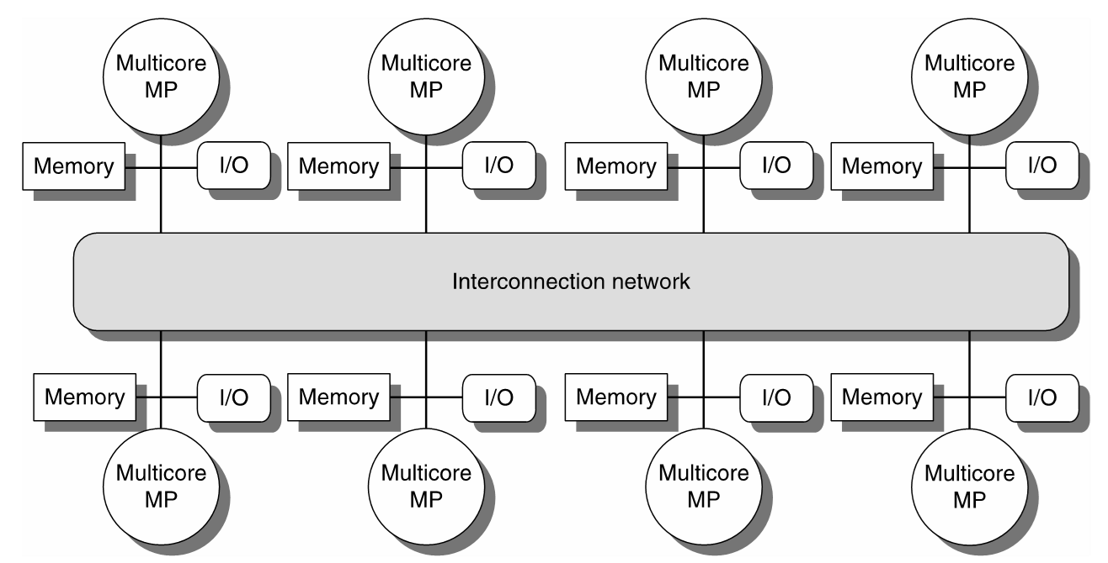
High Performance Computing (HPC) vs. High Throughput Computing (HTC)
High Performance Computing
Usually one cluster (e.g. Euler) or one massively parallel machine (e.g. IBM Blue Gene or Cray) that is dedicated to running one large application that requires a lot of memory, a lot of compute power, and a lot of communication
Example: each particle in a MD simulation requires (due to long range electrostatic interaction) to keep track of a large number of particles that it interacts with. Needs to query and figure out where these other particles are at any time step of the numerical integration
What is crucial is the interconnect between the processing units
Typically some fast dedicated interconnect (e.g. InfiniBand), which operates at 40 GB/s
Euclid@UW-Madison: 1 GB/s Ethernet, Bluewaters@UIU/C: 100 GB/s, Tianhe-I claims double the speed of Infiniband
Typically uniform hardware components: e.g. 100,000 Intel Xeon 5520, etc.
Expensive
HPC: this interconnect expected to be fast…

Slide 72
High Performance Computing (HPC) vs. High Throughput Computing (HTC)
High Throughput Computing
Usually a collection of heterogeneous compute resources linked through a slow connection, most likely Ethernet
Example: 120 Windows workstations in the CAE labs (all sorts of machines, some new, some old)
When CAE machine 58 runs an ABAQUS bone simulation there is no communication needed with CAE machine 83 that runs a different ABAQUS scenario
Don’t need to spend any money, you can piggyback on resources willing to make themselves available
Very effective to run Design of Experiments type analyses
Any two nodes might have very
different setups/assets
This interconnect
might be slow

Slide 73
High Performance Computing (HPC) vs. High Throughput Computing (HTC)
You can do HPC on a configuration that has slow interconnect
It will run very, very slow…
Conversely, you can do HTC on an IBM Blue Gene
You will use the processors but will waste the fast interconnect that made the machine expensive in the first place
You need to have the right licensing system in place to “check out” 10,000 ABAQUS licenses
University of Wisconsin-Madison well known due to pioneering work in the area of HTC
Professor Miron Livny in CS
UW-Madison solution for HTC: Condor, used by a broad spectrum of organizations from academia and industry

Slide 74
[new topic] HPC with the Message Passing Interface (MPI): Outline
Introduction to message passing and MPI
Point-to-Point Communication
Collective Communication
HPC w/ MPI: Closing Remarks

Slide 75
MPI: High-level overview
N instances of the same program are launched for execution independently as N distinct processes
Flynn Taxonomy classification: MIMD
MPI & Distributed Memory: enables a MIMD computing mechanism
Multiple Instruction and Multiple Data
Another way to look at it: Single Program Multiple Data (SPMD)

Slide 76
Parallel Computing w/ MPI: One way to look at it
CUDA: a small snippet of code (the “kernel”) run by all threads spawned via your exec. config.
OpenMP: all threads execute an omp parallel region; name of the game is work sharing
MPI: the *entire* code is executed in parallel by all processes

Slide 77
A First MPI Program
#include "mpi.h"
#include <iostream>
int main(int argc, char **argv) {
int my_rank, n;
char hostname[128];
MPI_Init(&argc,&argv);
MPI_Comm_rank(MPI_COMM_WORLD, &my_rank);
MPI_Comm_size(MPI_COMM_WORLD, &n);
gethostname(hostname, 128);
if (my_rank == 0) { /* master */
printf("I am the master: %s\n", hostname);
}
else { /* worker */
printf("I am a worker: %s (rank=%d/%d)\n", hostname, my_rank, n-1);
}
MPI_Finalize();
return 0;
}
Has to be called first, and once only
Nothing special about rank=0.
Has to be called last, and once only
[A. Snavely]→

Slide 78
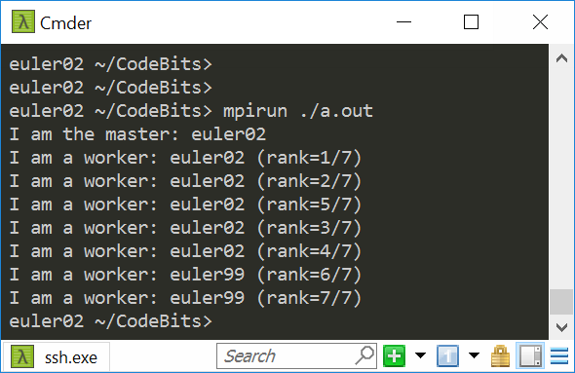
Program Output
I asked for 8 ranks
Got my 8 ranks spread out over two nodes: euler02 and euler99
Please use Slurm to run your jobs; instructions in the assignment. Colin can assist if you have questions

Slide 79
MPI: High-level Overview
Each MPI process, which runs most often on a core, executes the same executable at roughly the same time
Synchronization calls can be invoked; useful to coordinate the execution of the MPI job
Unlike in CUDA, here synchronization can be global

Slide 80
MPI: High-level Overview
What differentiates processes is their rank: processes with different ranks do different things (“branching based on the process rank”)
Very similar to GPU computing, where one thread did work based on its thread index
Very similar to OpenMP function omp_get_thread_num()

Slide 81
The Message-Passing Model
Each process has its own program counter and address space
Message passing enables communication among processes that have separate address spaces
Inter-process communication typically consists of
Synchronization, followed by…
… movement of data from one process’s address space to another process’s address space

Slide 82
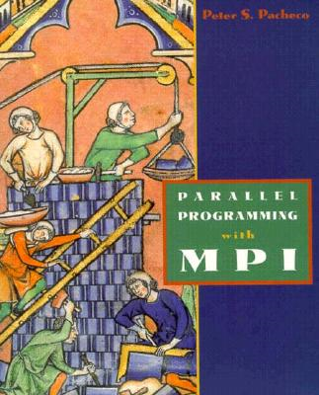
MPI: A Second Example Application
Example from Peter Pacheco’s book: “Parallel Programming with MPI”
/* greetings.c -- greetings program
*
* Send a message from all processes with rank != 0 to process 0.
* Process 0 prints the messages received.
*
* Input: none.
* Output: contents of messages received by process 0.
*
* See Chapter 3, pp. 41 & ff in PPMPI.
*/

Slide 83
MPI: A Second Example Application
#include "mpi.h"
#include <stdio.h>
#include <string.h>
int main(int argc, char* argv[]) {
int my_rank; /* rank of process */
int p; /* number of processes */
int source; /* rank of sender */
int dest; /* rank of receiver */
int tag = 0; /* tag for messages */
char message[100]; /* storage for message */
MPI_Status status; /* return status for receive */
MPI_Init(&argc, &argv); // Start up MPI
MPI_Comm_rank(MPI_COMM_WORLD, &my_rank); // Find out process rank
MPI_Comm_size(MPI_COMM_WORLD, &p); // Find out number of processes
if (my_rank != 0) {
/* Create message */
sprintf(message, "Greetings from process %d!", my_rank);
dest = 0;
/* Use strlen+1 so that '\0' gets transmitted */
MPI_Send(message, strlen(message)+1, MPI_CHAR, dest, tag, MPI_COMM_WORLD);
}
else { /* my_rank == 0 */
for (source = 1; source < p; source++) {
MPI_Recv(message, 100, MPI_CHAR, source, tag, MPI_COMM_WORLD, &status);
printf("%s\n", message);
}
}
MPI_Finalize(); // Shut down MPI
return 0;
} /* main */
Type of each sent item
Destination process rank
Identifier for this message
Buffer to be sent
Number of items to send

Slide 84
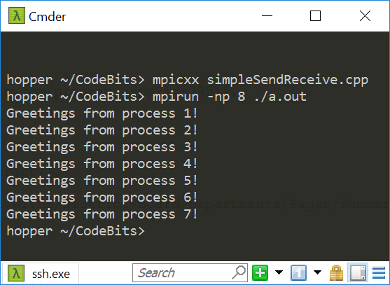
Program Output

Slide 85
The Message-Passing Programming Paradigm
The Sequential Programming Paradigm
data
memory
program
Processor/Process
Message-Passing Programming Paradigm
data
data
data
data
Distributed memory
program
program
program
program
communication network
Multiple processes
[ICHEC]→

Slide 86
Fundamental Concepts: Process/Program/Processor
A process is a software program executing a task on a processor
In other words, each process in an MPI job runs an instance of a program:
Program written in a conventional sequential language, e.g., C, C++, Fortran
The variables of each program have the same name but different locations (distributed memory) and different values
Communicate via special send & receive routines (message passing)
data
data
data
data
program
program
program
program
communication network

Slide 87
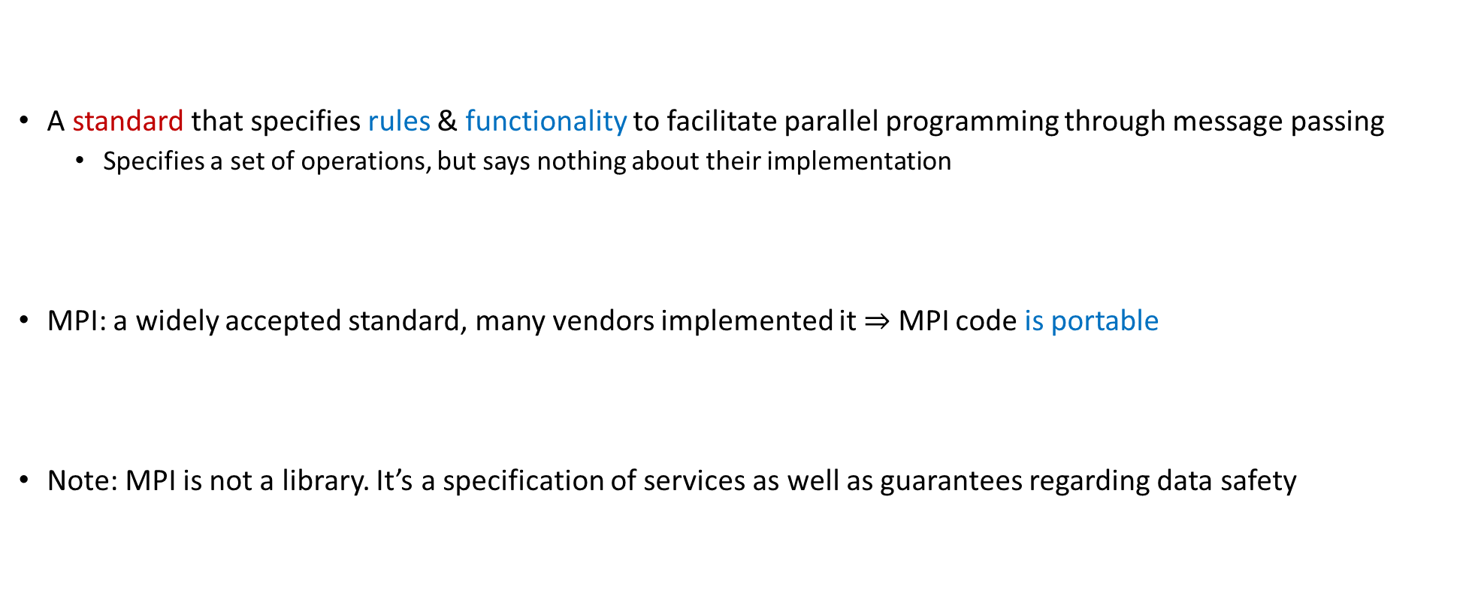
What is MPI?
A standard that specifies rules & functionality to facilitate parallel programming through message passing
Specifies a set of operations, but says nothing about their implementation
MPI: a widely accepted standard, many vendors implemented it $⇒$ MPI code is portable
Note: MPI is not a library. It’s a specification of services as well as guarantees regarding data safety

Slide 88
What is MPI?
Early implementation of MPI: MPICH (this is a library that implements [some of] the MPI specifications)
The CH comes from Chameleon, the software layer used in the original MPICH to provide portability to the existing message-passing systems
OpenMPI: another library that implements [some of] the MPI specifications
Joint effort of several groups from Los Alamos, Tennessee, Indiana University, Europe
Just as we discussed for OpenMP, MPI is a standard and different vendor provide libraries that implement a certain version of the standard and a certain set of features defined in that version of the standard

Slide 89
Where Can We Use MPI?
Message passing can be used wherever it is possible for processes to exchange messages:
Distributed memory systems
Networks of workstations
Even on a shared memory system; i.e., on one workstation that has many cores
NOTE [VERY IMPORTANT]:
Two OpenMP threads share the same virtual memory
Two MPI ranks do not share the same virtual memory (but they share the cache if they run on the same processor w/ multiple cores)
Two MPI ranks correspond to two *distinct* processes, which therefore have two different virtual memories they operate in

Slide 90
Why Care about MPI?
Today, MPI is what enables supercomputers to run at PFlops rates
At the node level:
A process might use GPU acceleration at the node level
A process might use OpenMP the multiple cores available on a node
Widely used in Scientific Computing, MPI has FORTRAN and C bindings

Slide 91
MPI: Pluses and Minuses
Pluses:
Access to lots of memory (across many nodes…)
Access to a lot of processors (across many nodes…)
No cache coherence overhead (if they don’t run on the same node)
Minuses:
High latency in communication
Low bandwidth compared to what we’ve seen so far (GPU & OpenMP on a workstation)
You have to manage the process of sharing data amongst processes
NOTE: up-to-date typical latencies & bandwidth of various systems available here
Ranges: 5-10 usec & 1-80 GB/s (BW depends heavily on size of the big-iron machine; more like 1-5 GB/s)

Slide 92
MPI vs. CUDA
When would you use GPU computing and when would you use MPI-based parallel programming?
Use GPU
If your data fits the memory constraints associated with GPU computing
You have parallelism at a fine grain so that you the SIMD paradigm applies
Example: Image processing
Use MPI-enabled parallel programming
If you have a very large problem, with a lot of data that needs to be spread out across several machines
Example: Large-scale CFD, FEA
NOTE: there are many machines on which HPC is done using both MPI and CUDA

Slide 93
MPI on Euler [Selecting MPI Distribution]
What’s available: OpenMPI, MVAPICH, MVAPICH2
OpenMPI is default on Euler
To load OpenMPI environment variables:
Typically not needed, should be done automatically for you
>> module load openmpi

Slide 94
Compiling MPI Code by Hand
Most MPI distributions provide wrapper scripts named mpicc or mpicxx
Adds in –L, -l, -I, etc. flags for MPI
Passes any options to your native compiler (gcc)
Very similar to what nvcc did for CUDA – it’s a compile driver…
>> mpicxx -o integrate_mpi integrate_mpi.cpp

Slide 95
Example, Running on Euler [Context: running the executable integrate_mpi]
### BEGINNING OF submit_mpi.sh SCRIPT ###
#!/bin/bash
#SBATCH -t 0-5:0:0
#SBATCH -o output.txt
cd $SLURM_SUBMIT_DIR
mpirun ./integrate_mpi
### END OF SCRIPT ###
euler $ sbatch –p wacc --gres=infiniband:1 -N 2 --ntasks-per-node=4 submit_mpi.sh
euler $ cat output.txt
8 32.121040666358297 in 2.171963s
euler $ sbatch –p wacc --gres=infiniband:1 -N 2 --ntasks-per-node=2 submit_mpi.sh
euler $ cat output.txt
4 32.121040666358297 in 4.600204s
euler $ sbatch –p wacc --gres=infiniband:1 -N 1 --ntasks-per-node=1
euler $ cat output.txt
1 32.121040666358297 in 15.163330s

Slide 96
Running MPI, In General
mpirun [-np #] [-machinefile file] <program> [<args>]
Number of processors. Inside SLURM, this is handled automatically.
List of hostnames to use. Inside SLURM, this is handled automatically.
Your program and its arguments
-np will be set automatically by SLURM. Do not use it.
-machinefile will be set automatically by SLURM. Do not use it.
See the mpirun manpage for more options

Slide 97
MPI with CMake
Using MPI in CMake a lot like using OpenMP
To enable MPI, the FindMPI CMake module is called using find_package
The MPI module sets a few flags which should be added to your target
find_package(MPI REQUIRED)
add_executable(problemX problemx.c)
target_include_directories(problemX ${MPI_C_INCLUDE_PATH})
target_compile_options(problemX ${MPI_C_COMPILE_FLAGS})
target_link_libraries(problemX ${MPI_C_LIBRARIES})
NOTE: Other language bindings such as MPI_CXX_* or MPI_FORTRAN_* may also be used.
97

